Slide 1
Week 2
BUS 696: Machine Learning for Managers
Prof. Jonathan Hersh

Slide 2
BUS 696: Week 2 Outline
AI/ML in the News
Data Modeling Project Cycle
R Coding Basics and Exploratory Data Analysis
Basic math in R
Vectors
Factors
Dplyr basics: filter(), select(), arrange(), rename(), mutate()
Bias Variance Tradeoff

Slide 3
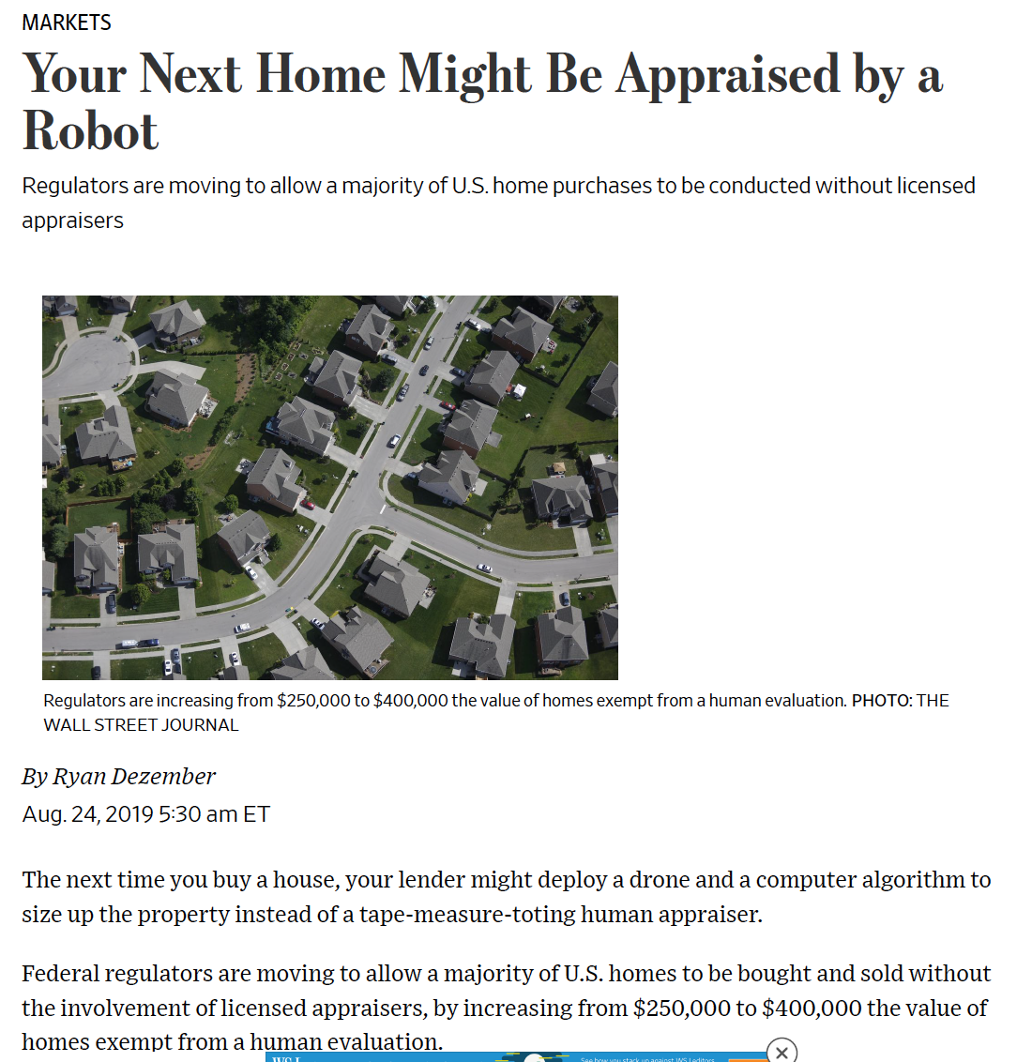

Slide 4
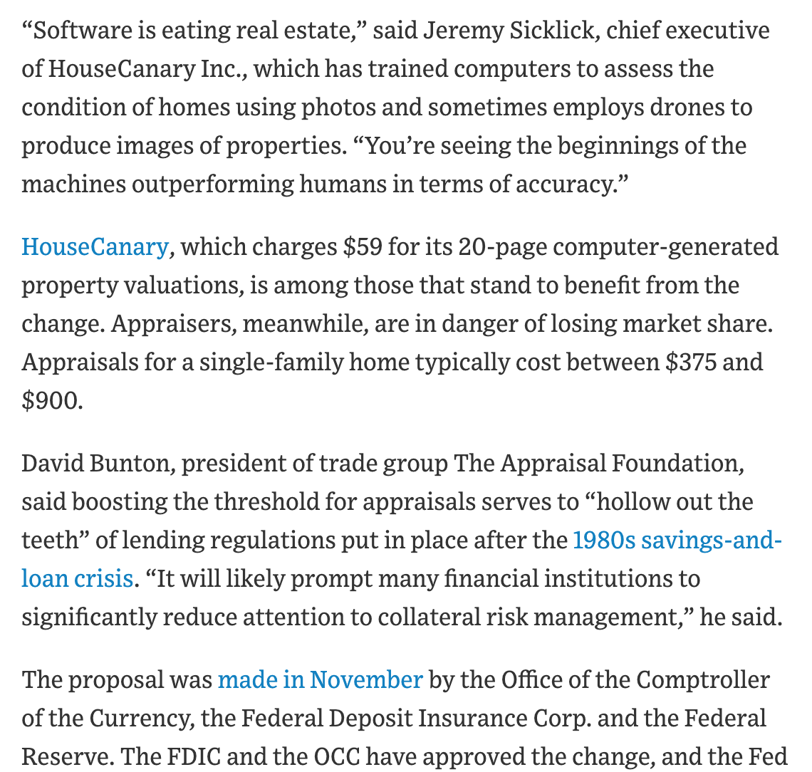

Slide 5
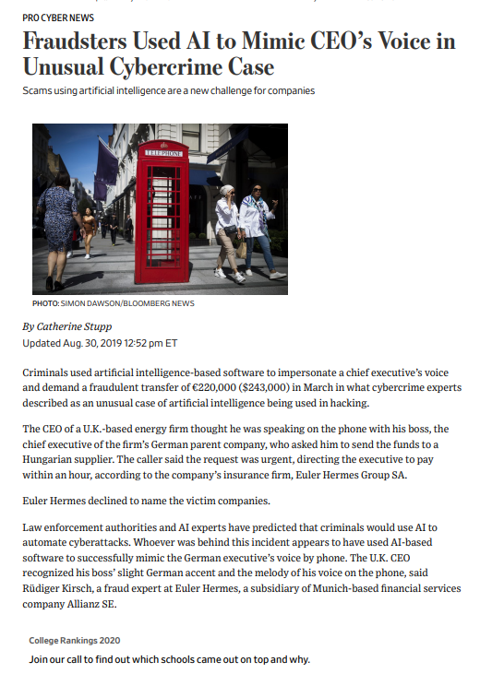

Slide 6
BUS 696: Week 2 Outline
AI/ML in the News
Data Modeling Project Cycle
R Coding Basics and Exploratory Data Analysis
Basic math in R
Vectors
Factors
Dplyr basics: filter(), select(), arrange(), rename(), mutate()
Bias Variance Tradeoff

Slide 7
Data Modeling Process

Slide 8
A More Realistic Data Project Life-Cycle Model
Business Use Case
Predictive Modeling
Model Diagnostics and Validation
Communication and Documentation
Data Exploration
Feature Engineering
Data Cleaning and Curation

Slide 9
80/20 Rule for Results vs Effort

Slide 10
80/20 Rule for Data Science

Slide 11
How do Data Scientists Spend Their Time

Slide 12
Least Enjoyable Aspect of Data Science

Slide 13
BUS 696: Week 2 Outline
AI/ML in the News
Data Modeling Project Cycle
R Coding Basics and Exploratory Data Analysis
Basic math in R
Vectors
Factors
Dplyr basics: filter(), select(), arrange(), rename(), mutate()
Bias Variance Tradeoff

Slide 14
BUS 696: Week 2 Outline
AI/ML in the News
Data Modeling Project Cycle
R Coding Basics and Exploratory Data Analysis
Basic math in R
Vectors
Factors
Dplyr basics: filter(), select(), arrange(), rename(), mutate()
Bias Variance Tradeoff

Slide 15
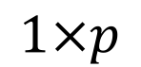

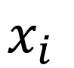
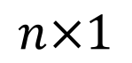

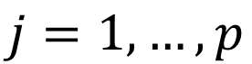
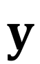
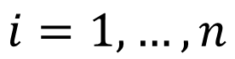
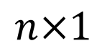
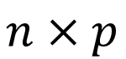
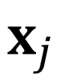
Recall: $X$, $x_{i}$, $x_{j}$ and $y$ for Data
Admit | GRE | GPA
0 | 380 | 3.61
1 | 660 | 3.67
1 | 800 | 4.00
0 | 520 | 2.93
1 | 760 | 3.00
$$X$$
$$x_{i}$$
$$x_{j}$$
$$y$$
$$n×p$$
$$1×p$$
$$n×1$$
$$n×1$$
$$i=1,…,n$$
$$j=1,…,p$$

Slide 16
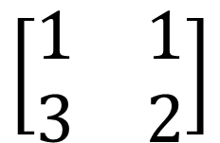
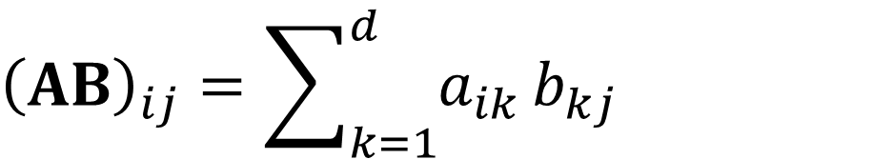
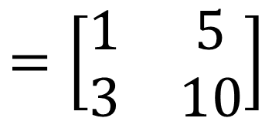
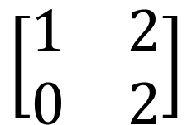
Matrix Multiplication
$${\left(AB\right)}_{ij}=\sum_{k=1}^{d}{a_{ik}}b_{kj}$$
$$\left[\begin{matrix}1 & 1 \\ 3 & 2\end{matrix}\right]$$
$$\left[\begin{matrix}1 & 2 \\ 0 & 2\end{matrix}\right]$$
$$=\left[\begin{matrix}1 & 5 \\ 3 & 10\end{matrix}\right]$$

Slide 17
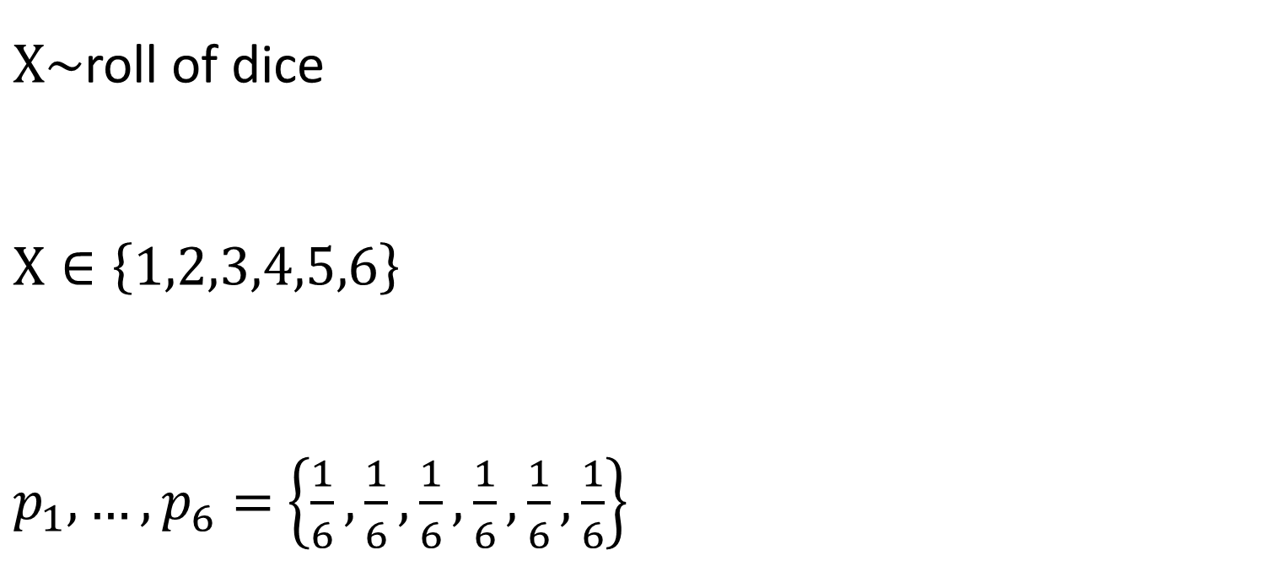
Random Variable: Variable whose possible values are outcomes of some random process
$X\sim$roll of dice
$$X∈\left\{1,2,3,4,5,6\right\}$$
$p_{1},…,p_{6}=$ $\left\{\frac{1}{6},\frac{1}{6},\frac{1}{6},\frac{1}{6},\frac{1}{6},\frac{1}{6}\right\}$

Slide 18
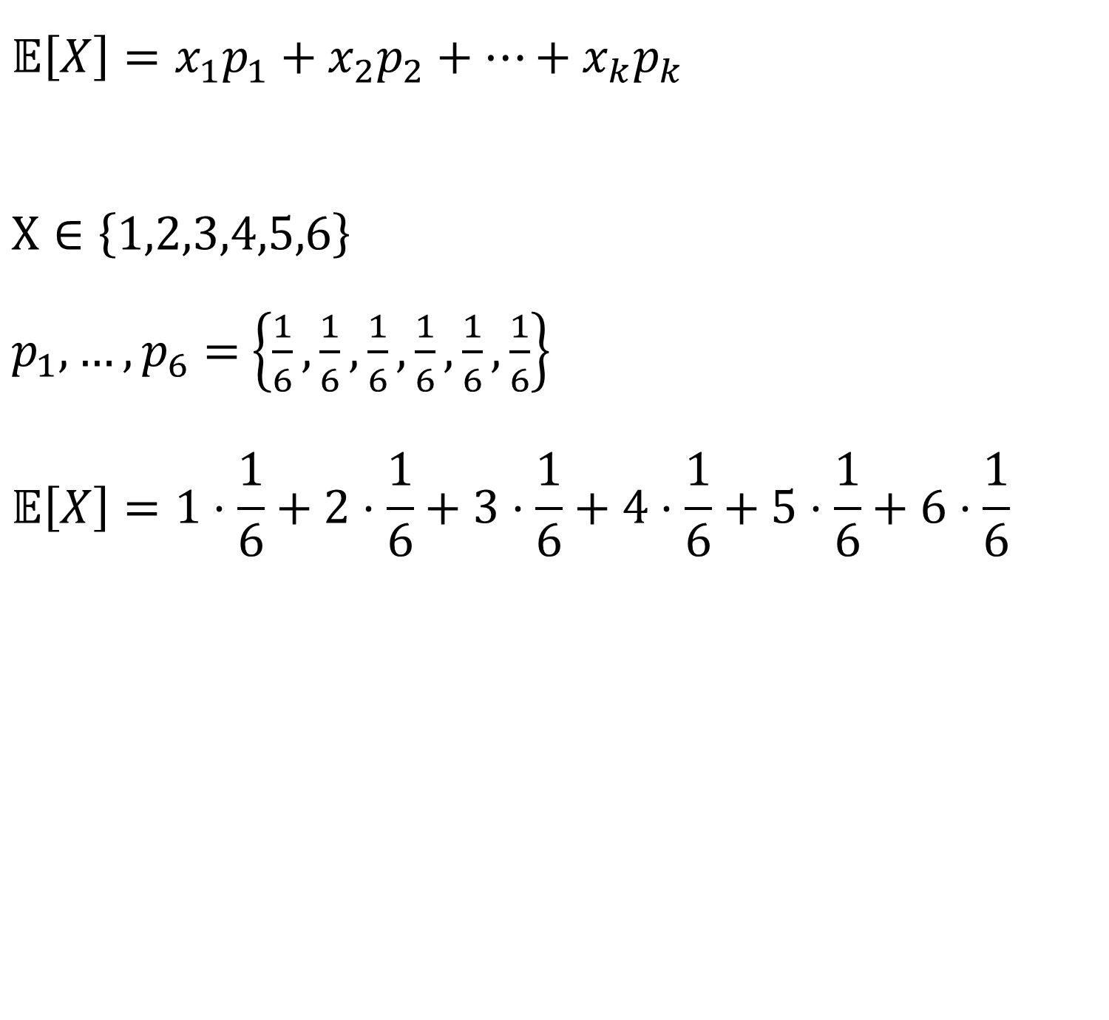
Expected Value of R.v.: long run average value
$$𝔼\left[X\right]=x_{1}p_{1}+x_{2}p_{2}+…+x_{k}p_{k}$$
$$X∈\left\{1,2,3,4,5,6\right\}$$
$p_{1},…,p_{6}=$ $\left\{\frac{1}{6},\frac{1}{6},\frac{1}{6},\frac{1}{6},\frac{1}{6},\frac{1}{6}\right\}$
$$𝔼\left[X\right]=1⋅\frac{1}{6}+2⋅\frac{1}{6}+3⋅\frac{1}{6}+4⋅\frac{1}{6}+5⋅\frac{1}{6}+6⋅\frac{1}{6}$$

Slide 19
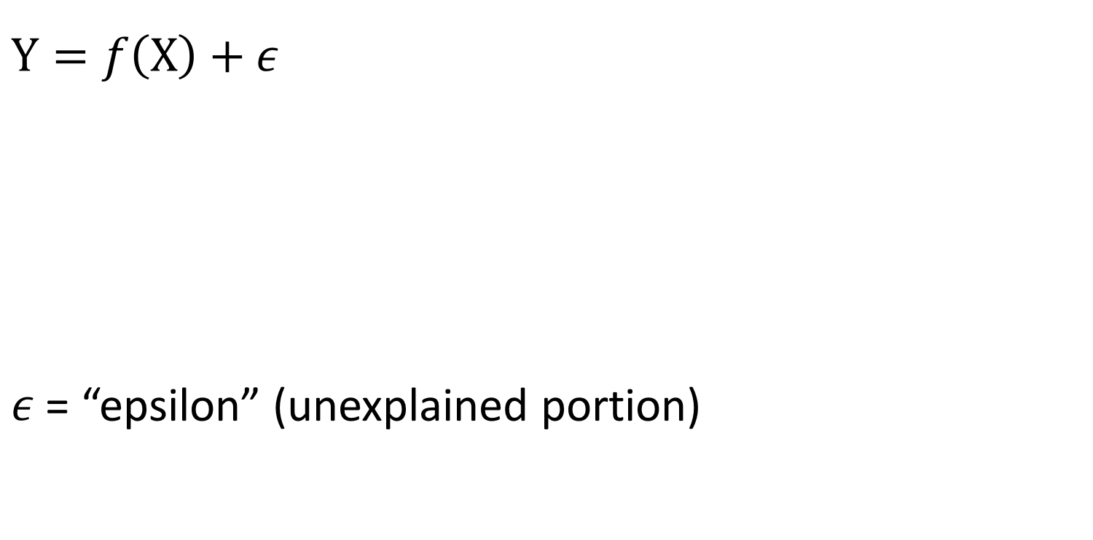
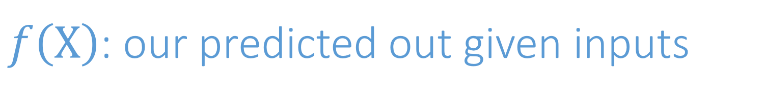
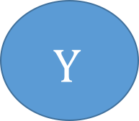
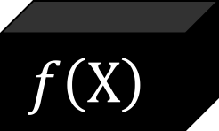

$f\left(X\right)$: our predicted out given inputs
$$Y=f\left(X\right)+ε$$
$ε$ = “epsilon” (unexplained portion)
$$X$$
$$f\left(X\right)$$
$$Y$$

Slide 20
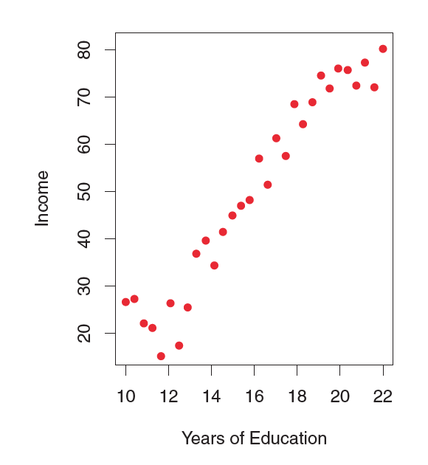
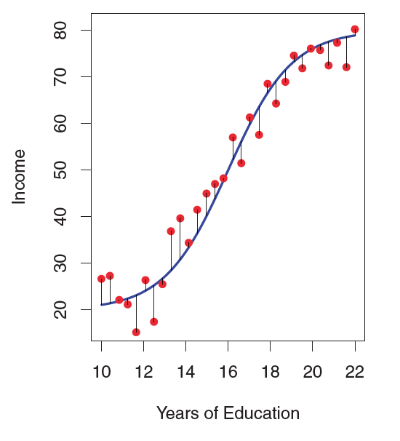
Example: education and income

Slide 21
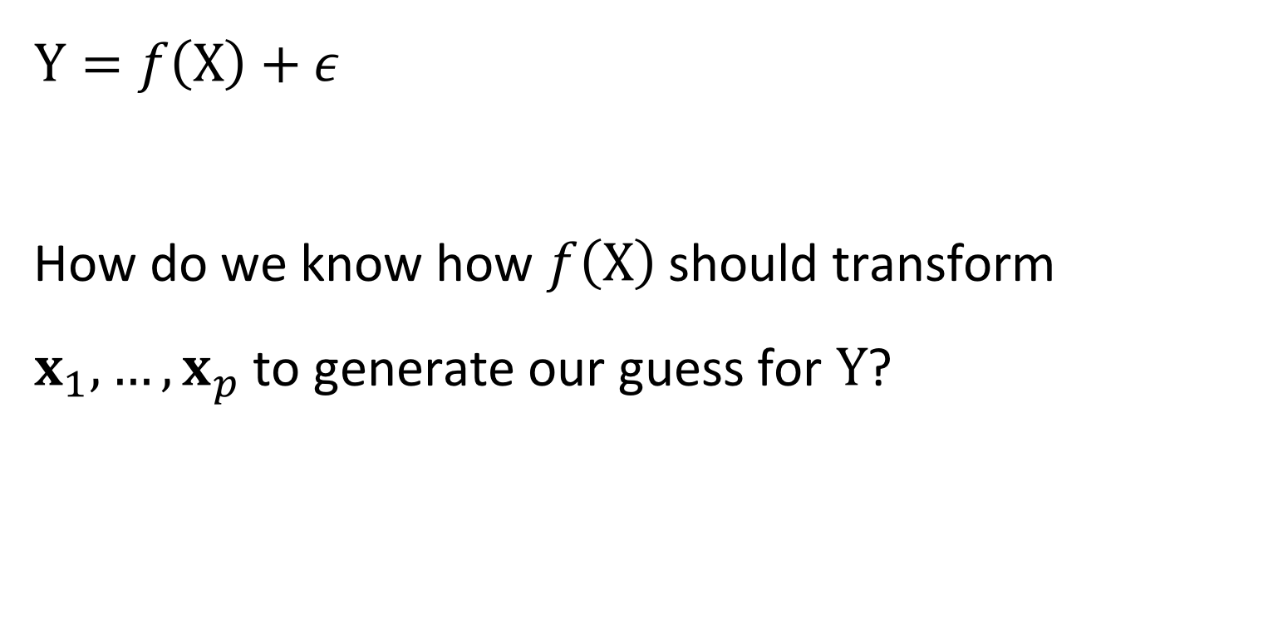
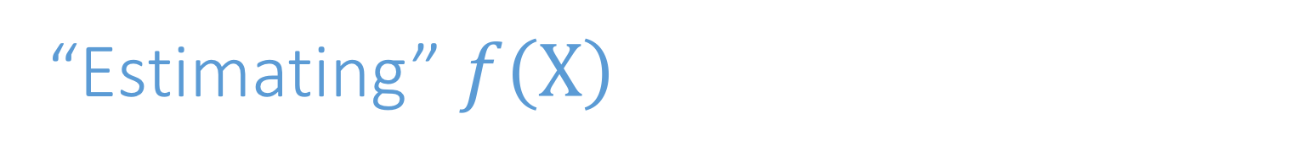
“Estimating” $f\left(X\right)$
$$Y=f\left(X\right)+ε$$
How do we know how $f\left(X\right)$ should transform $x_{1},…,x_{p}$ to generate our guess for $Y$?

Slide 22
Bias-Variance Tradeoff

Slide 23
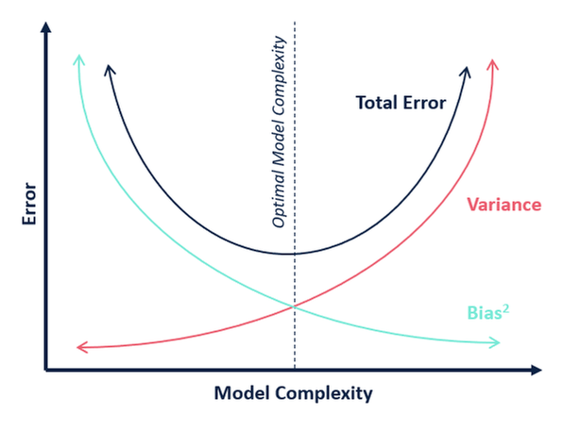
Bias-Variance Tradeoff

Slide 24
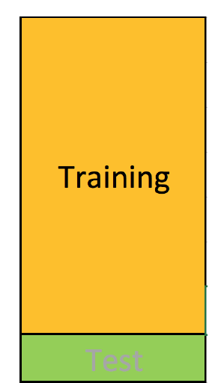
Testing/Training Split
Training set: (observation-wise) subset of data used to develop models

Slide 25
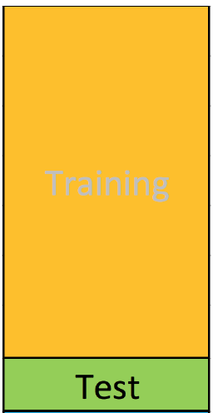
Testing/Training Split
Training set: (observation-wise) subset of data used to develop models
Test set: subset of data used during intermediate stages to “tune” model parameters
Rule of thumb 75% training 25% test -ish

Slide 26
Bias and Variance (conceptually)
Bias: Tendency of an in-sample statistic to over or under estimate the statistic in the population
Variance: Tendency to noisily estimate a statistic. E.g., sensitivity to small fluctuations in the training dataset.

Slide 27
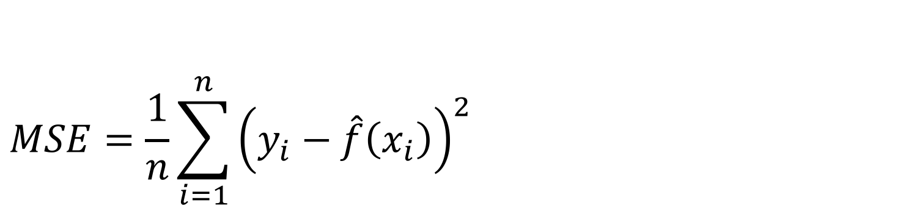
Assessing Model Accuracy
$$MSE=\frac{1}{n}\sum_{i=1}^{n}{{\left(y_{i}−\hat{f}\left(x_{i}\right)\right)}^{2} }$$

Slide 28
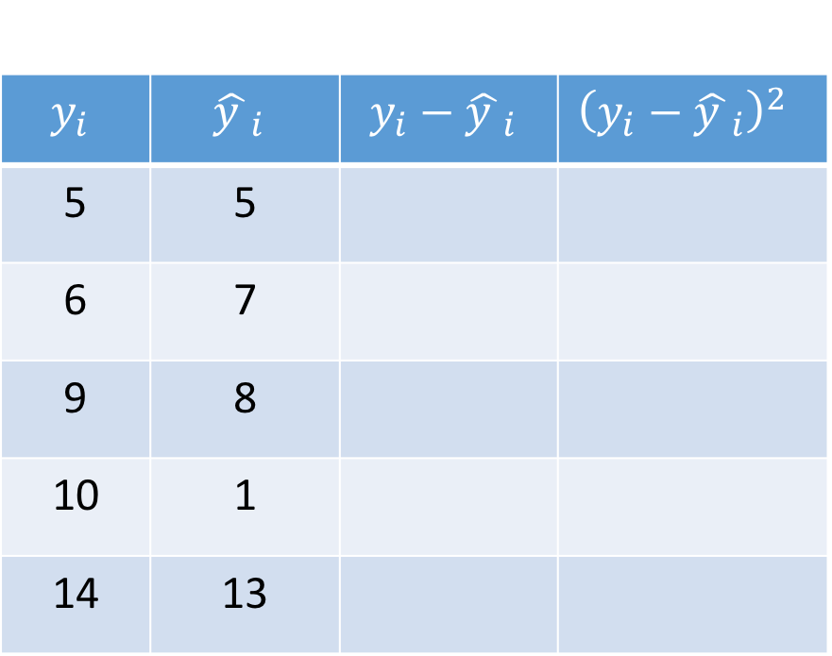
Assessing Model Accuracy
$$MSE=\frac{1}{n}\sum_{i=1}^{n}{{\left(y_{i}−\hat{f}\left(x_{i}\right)\right)}^{2} }$$
$$y_{i}$$ | $${\hat{y }}_{i}$$ | $$y_{i}−{\hat{y }}_{i}$$ | $${\left(y_{i}−{\hat{y }}_{i}\right)}^{2}$$
5 | 5
6 | 7
9 | 8
10 | 1
14 | 13

Slide 29
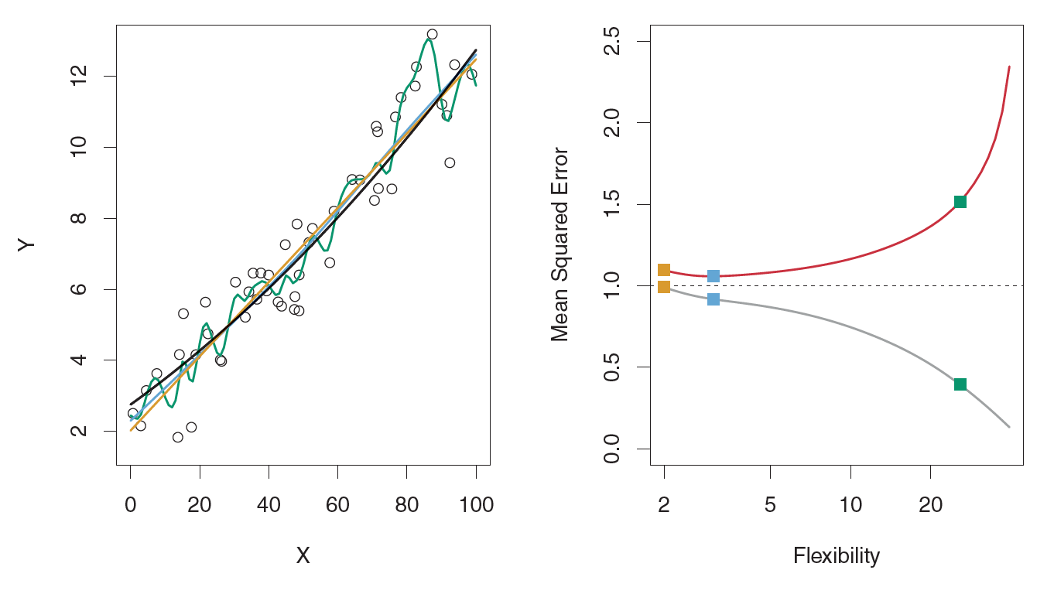
Example: Overfitting (DGP Linear)

Slide 30
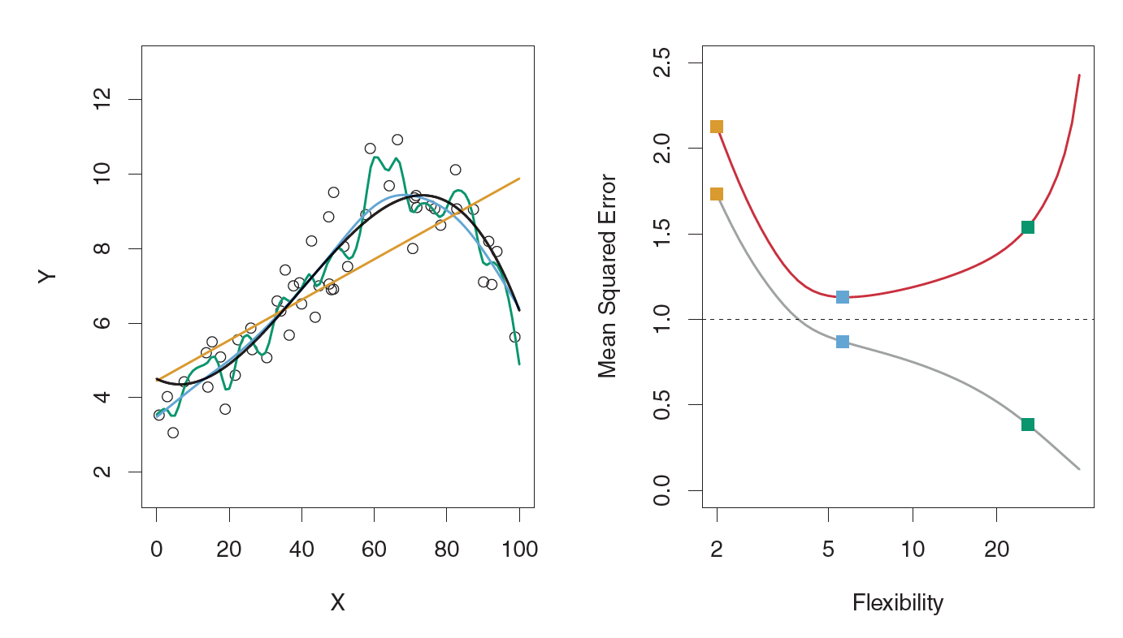
Example: Overfitting (DGP Slightly Complicated)

Slide 31
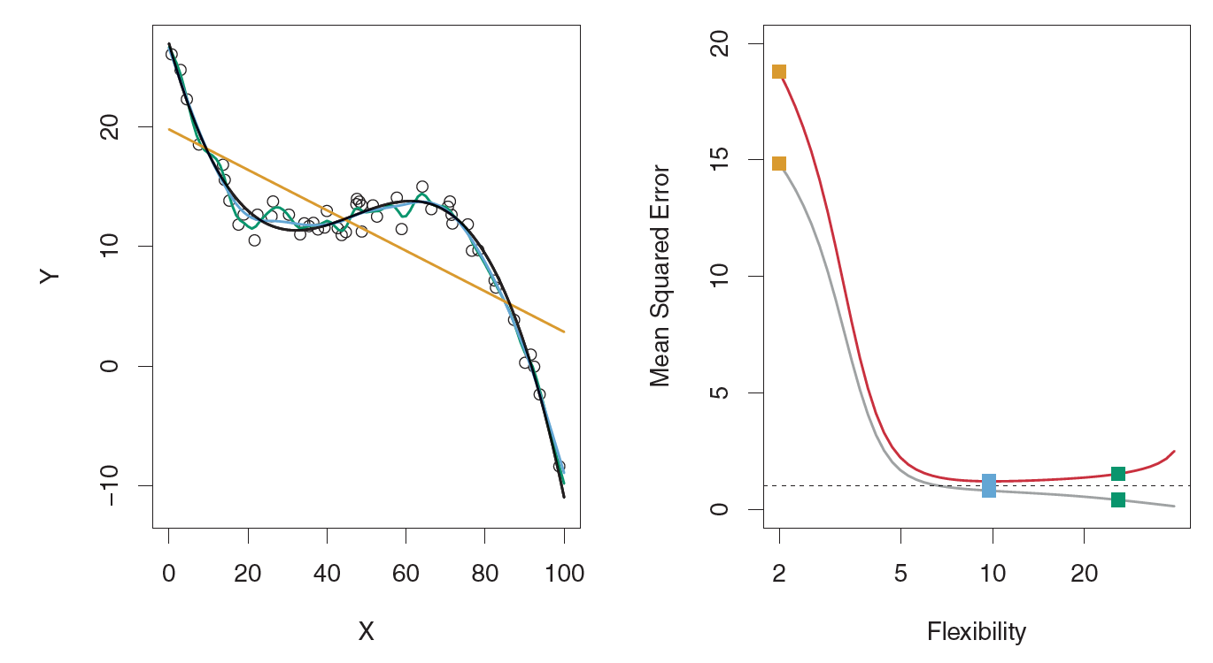
Example: Overfitting (DGP Very Complicated)

